Slide 1
Unit 1
Introduction to C Programming

Slide 2
Terminology
Problem
Program
Language

Slide 3
Program:
A program is a set of sequenced instruction to cause a computer to perform particular operation or to solve the given problem
Programming:
Process of developing such program is called programming
Programmer:
Person who does programming is called programmer

Slide 4
Programming Language:
The language that is used to develop the program is called programming language
“Programming languages are set of instruction used to write a program”
The language used to communicate with computer is known as programming language
program can be categorized based on how close to normal speech they are, and thus how far from the computer’s internal languages

Slide 5
Types of Programming Languages
Programmers write instructions in various programming languages, some directly understandable by computers and others requiring intermediate translation steps.
Hundreds of such languages are in use today. These may be divided into three general types:
Machine languages
Assembly languages
High-level languages

Slide 6
Machine Languages
The machine-level language is a language that consists of a set of instructions that are in the binary form 0 or 1.
As we know that computers can understand only machine instructions, which are in binary digits, i.e., 0 and 1, so the instructions given to the computer can be only in binary codes.
Creating a program in a machine-level language is a very difficult task as it is not easy for the programmers to write the program in machine instructions.
It is error-prone as it is not easy to understand, and its maintenance is also very high.
A machine-level language is not portable as each computer has its machine instructions, so if we write a program in one computer will no longer be valid in another computer.

Slide 7
Assembly Language
The assembly language contains some human-readable commands such as mov, add, sub, etc.
The problems which we were facing in machine-level language are reduced to some extent by using an extended form of machine-level language known as assembly language.
Since assembly language instructions are written in English words like mov, add, sub, so it is easier to write and understand.
As we know that computers can only understand the machine-level instructions, so we require a translator that converts the assembly code into machine code. The translator used for translating the code is known as an assembler.
The assembly language code is not portable because the data is stored in computer registers, and the computer has to know the different sets of registers.

Slide 8
High-Level Language
The high-level language is a programming language that allows a programmer to write the programs which are independent of a particular type of computer.
The high-level languages are considered as high-level because they are closer to human languages than machine-level languages.
When writing a program in a high-level language, then the whole attention needs to be paid to the logic of the problem.
A compiler is required to translate a high-level language into a low-level language.

Slide 9
Low-level language | High-level language
It is a machine-friendly language, i.e., the computer understands the machine language, which is represented in 0 or 1. | It is a user-friendly language as this language is written in simple English words, which can be easily understood by humans.
The low-level language takes more time to execute. | It executes at a faster pace.
It requires the assembler to convert the assembly code into machine code. | It requires the compiler to convert the high-level language instructions into machine code.
The machine code cannot run on all machines, so it is not a portable language. | The high-level code can run all the platforms, so it is a portable language.
It is memory efficient. | It is less memory efficient.
Debugging and maintenance are not easier in a low-level language. | Debugging and maintenance are easier in a high-level language.

Slide 10
Programming Approach
Top-Down Model
It is a system design approach where design starts from the system as a whole.
Complete System is then divided into smaller sub-applications with more details.
Each part again goes through the top-down approach till the complete system is designed with all minute details.
The basic idea in top-down approach is to break a complex algorithm or a problem into smaller segments called modules
Top Down approach is also termed as breaking the bigger problem into smaller problems and solving them individually in recursive manner.

Slide 11
Bottom-Up Model
It is a system design approach where parts of the system are defined in details.
Once these parts are designed and developed, then these parts or components are linked together to prepare a bigger component.
This approach is repeated until the complete system is built.
Advantage of Bottom-Up Model is in making decisions at very low level and to decide the re-usability of components.

Slide 12
key | Bottom-Up Model | Top-Down Model
Focus | In Bottom-Up Model, the focus is on identifying and resolving smallest problems and then integrating them together to solve the bigger problem. | In Top-down Model, the focus is on breaking the bigger problem into smaller one and then repeat the process with each problem.
Language | Bottom-Up Model is mainly used by object oriented programming languages like Java, C++ etc. | Top-Down Model is followed by structural programming languages like C, Fortran etc.
Redundancy | Bottom-Up model is better suited as it ensures minimum data redundancy and focus is on re-usability. | Top-down model has high ratio of redundancy as the size of project increases.
Interaction | Bottom-Up model have high interactivity between various modules. | Top-down model has low interactivity between various modules.
Issues | In Bottom-Up, some time it is difficult to identify overall functionality of system in initial stages. | In Top-Down, it may not be possible to break the problem into set of smaller problems.

Slide 13
ALGORITHM
An algorithm is a process or set of rules to be followed in calculations or other problem-solving operations, especially by a computer
Formally defined procedure for performing some calculation
An effective procedure for solving a problem in a finite number of steps
An algorithm gives the step by step description of how to arrive at a solution

Slide 14
Characteristics of algorithm
Accuracy
Clarity
Not even a single instruction must be repeated infinitely
After the algorithm gets terminated, the desired result must be obtained

Slide 15
Control Structures used in Algorithms
Sequence means that each step of the algorithm is executed in the specified order.
Decision statements are used when the execution of a process depends on the outcome of some condition.
Repetition involves executing one or more steps for a number of times. Can be implemented using constructs such as while, do-while, and for loops.

Slide 16
Algorithm
Algorithm for finding sum of any two numbers
Step 1: START
Step 2: Display “Enter two numbers”
Step 3: Read first number as A and second number as B
Step 4: set C=A+B
Step 5: Display “C as sum of two numbers”
Step 6: END

Slide 17
Algorithm for calculating the simple interest using formula SI=(P*T*R)/100
Step 1: START
Step 2: Display “Enter principal, rate and time”
Step 3: Read Principal as P, Time as T and rate as R
Step 4: Calculate simple interest SI=(P*T*R)/100
Step 5: Display SI as simple interest
Step 6: END

Slide 18
Algorithm to determine whether a number is odd or even
Step 1: START
Step 2: Display “Enter any number”
Step 3: Read a number as Num from user
Step 4: Calculate remainderusing division of Num by 2 (REM=Num%2)
Step 5: IF REM=0, THEN
Display “The number is even”
ELSE
Display “The number is odd”
Step 6: END

Slide 19
Algorithm to find the sum of first N naturals numbers
Step 1: START
Step 2: Display “Enter a number “
Step 3: Read number as N
Step 4: SET i=1, sum=0
Step 5: Repeat Step 6 while i<=N
Step 6: SET sum=sum+I
SET i=i+1
Step 5: Display sum
Step 6: END

Slide 20
Write an algorithm to find largest of two numbers
Write an algorithm to swap two numbers
Write an algorithm to find the largest number among three numbers
Write an algorithm to read N number from user and display the sum of all numbers between 1 and N.
Write an algorithm to print the grade obtained by a student using the following rules:
Marks Grade
Above 80 Distinction
60-79 first division
50-69 second division
40-59 third division
Less than 40 fail

Slide 21
FLOWCHART
A graphical or symbolic representation of a process
Used to design and document complex processes to help the viewers to visualize the logic of the process
Provides a better understanding of the process and find flaws, bottlenecks, and other less obvious features within it
Usually drawn in the early stages of formulating computer solutions
When designing a flowchart, each step in the process is depicted by a different symbol and is associated with a short description

Slide 22
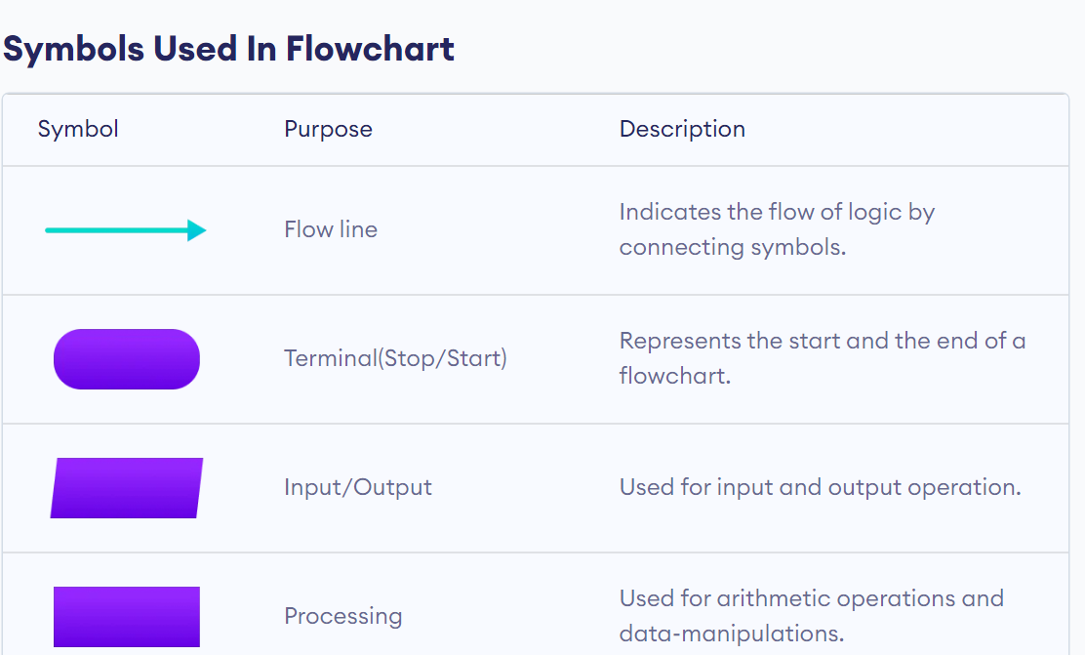

Slide 23
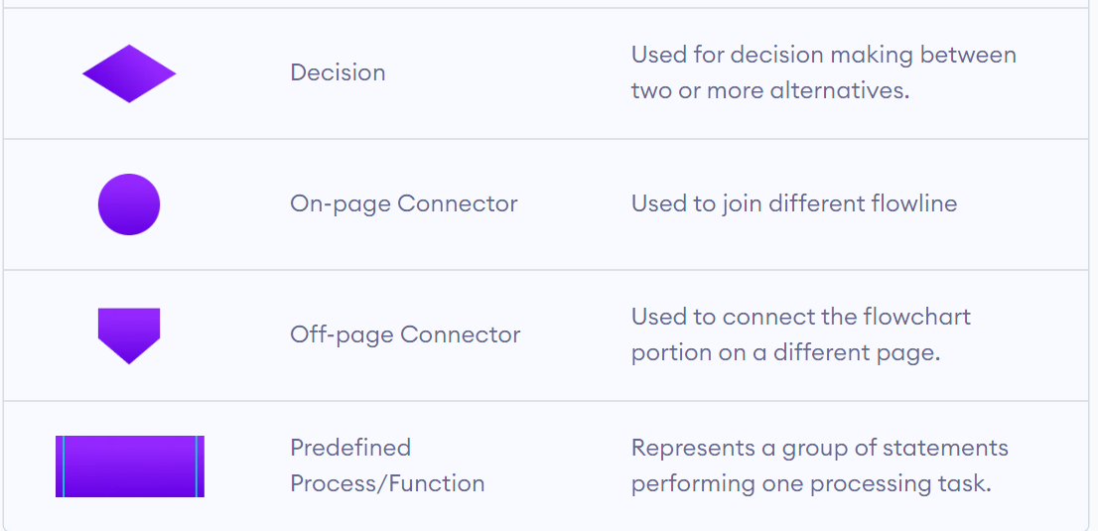

Slide 24
C Programming
The C Language is developed for creating system applications that directly interact with the hardware devices such as drivers, kernels, etc.
C programming is considered as the base for other programming languages, that is why it is known as mother language.
It can be defined by the following ways:
Mother language
System programming language
Procedure-oriented programming language
Structured programming language
Mid-level programming language

Slide 25
C as a mother language
Most of the compilers, JVMs, Kernels, etc. are written in C language, and most of the programming languages follow C syntax, for example, C++, Java, C#, etc.
C as a system programming language
A system programming language is used to create system software.
C language is a system programming language because it can be used to do low-level programming (for example driver and kernel

Slide 26
C as a procedural language
A procedural language specifies a series of steps for the program to solve the problem.
A procedural language breaks the program into functions, data structures, etc.
C as a structured programming language
Structure means to break a program into parts or blocks so that it may be easy to understand.
In the C language, we break the program into parts using functions. It makes the program easier to understand and modify.

Slide 27
C as a mid-level programming language
C is considered as a middle-level language because it supports the feature of both low-level and high-level languages.
A Low-level language is specific to one machine, i.e., machine dependent. It is machine dependent, fast to run. But it is not easy to understand.
A High-Level language is not specific to one machine, i.e., machine independent. It is easy to understand.

Slide 28
History of C
C programming language was developed in 1972 by Dennis Ritchie at bell laboratories of AT&T (American Telephone & Telegraph), located in the U.S.A.
Dennis Ritchie is known as the founder of the c language.
It was developed to overcome the problems of previous languages such as B, BCPL, etc.
Initially, C language was developed to be used in UNIX operating system. It inherits many features of previous languages such as B and BCPL.

Slide 29
Features of C Language
Small
C is a language of few words, containing only a handful of terms, called keywords, which serve as the base on which language’s functionality is built
Simple
C is a simple language in the sense that it provides a structured approach (to break the problem into parts), the rich set of library functions, data types, etc.
Machine Independent or Portable
Unlike assembly language, c programs can be executed on different machines with some machine specific changes. Therefore, C is a machine independent language.

Slide 30
Mid-level programming language
supports the feature of both low-level and high-level languages.
Structured programming language
C is a structured programming language in the sense that we can break the program into parts using functions. So, it is easy to understand and modify.

Slide 31
First C Program
#include<stdio.h>
void main()
{
printf("Hello World");
}
#include <stdio.h> includes the standard input output library functions. The printf() function is defined in stdio.h .
main() The main() function is the entry point of every program in c language.
printf() function is used to print data on the console.

Slide 32
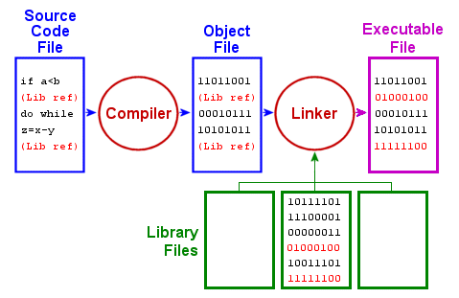

Slide 33
